Slide 2
NETFLIX Clone
Submitted to:
Department of Computer Science and Engineering

Slide 3
Supervised by: Prof. Gajendra Chauhan
Aryan Gupta

Slide 4
Project Presentation Outline
Introduction
Description
Website Structure
Technology used
Working
User Interface
Conclusions

Slide 5
Introduction
Our project, named "Netflix Clone," is a web application designed to replicate the front-end of the popular streaming service, Netflix. The goal is to create an interactive and user-friendly platform where users can explore content and sign up for an account.

Slide 6
Description
The Netflix Clone offers a simplified version of Netflix's front page, featuring a "Get Started" button and an email input field for user registration. The proposed solution aims to provide users with a familiar interface for discovering and accessing content while focusing on the sign- process.

Slide 7
Website Structure
Components:
Main Navigation Bar
Featured Content Section
Categories and Genres
Sections:
Home
Footer(contact)
Sign In / Sign Up

Slide 8
Objectives
Create a user-friendly front-end resembling Netflix's layout.
Implement a seamless email registration process.
Gain hands-on experience in web development and database management.

Slide 9
Technology Used
Front-end: HTML, CSS
Back-end: PHP
Database: MySQL
Server: XAMPP
The chosen technologies were selected for their simplicity, ease of integration, and compatibility with web development requirements.

Slide 10
Working
Homepage Layout:
The homepage features a "Get Started" button.
An email input field is provided for user registration.
Database Integration:
PHP scripts handle user input and interact with the MySQL database.
User email addresses are stored securely in the database.
XAMPP Server:
XAMPP is utilized to run the Apache server for PHP execution.
MySQL database is managed using phpMyAdmin.
User Interaction:
Users click the "Get Started“ and “Sign-in” button and enter their email address.
PHP scripts validate and store the email in the database.

Slide 11
User Interface
Design Elements:
Consistent color scheme and branding.
User-friendly layouts.
Showcase of key pages (home, sign-in, sign-up).

Slide 12
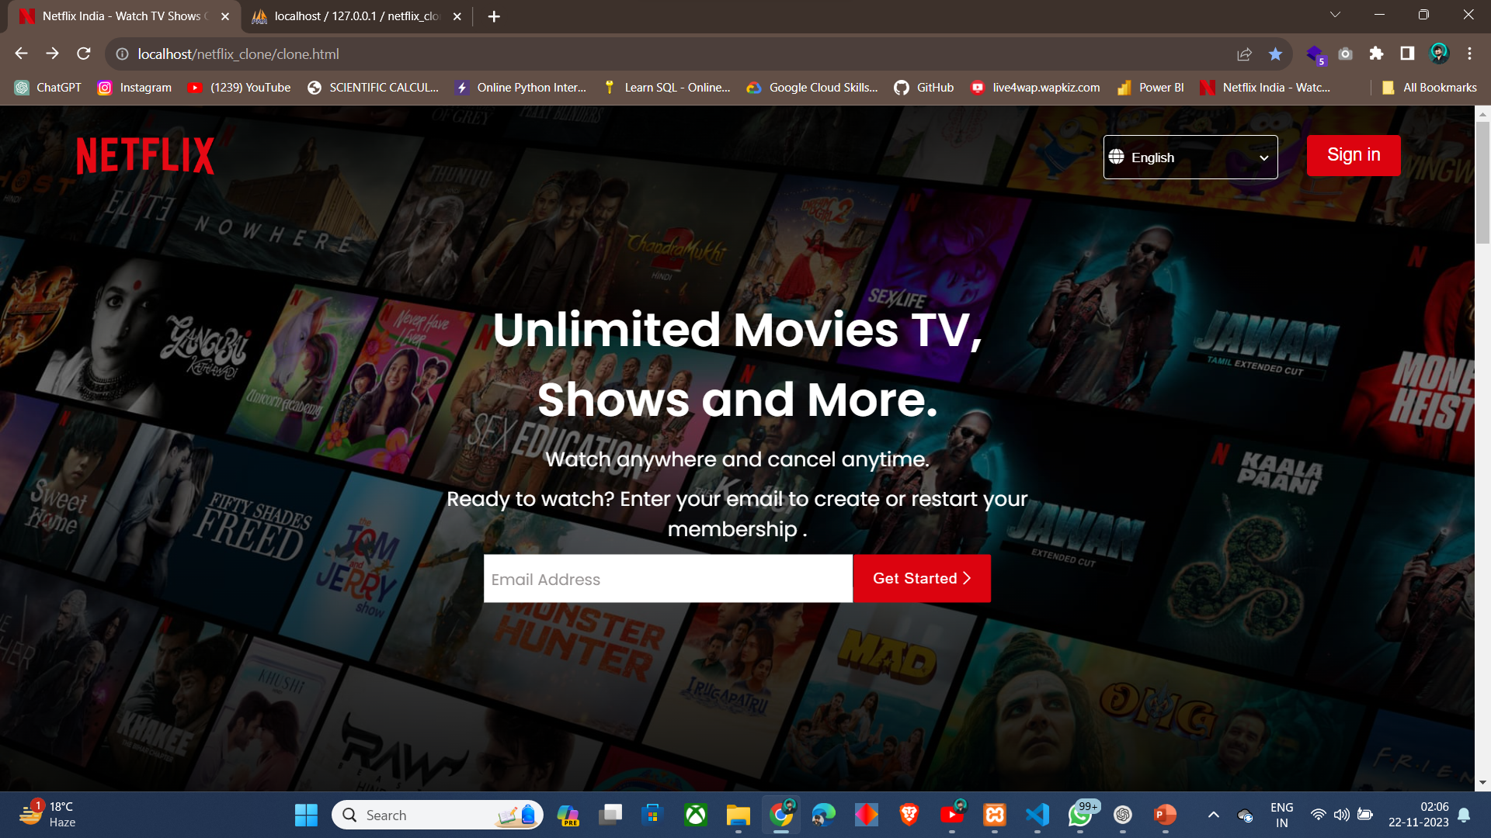
User Interface

Slide 13
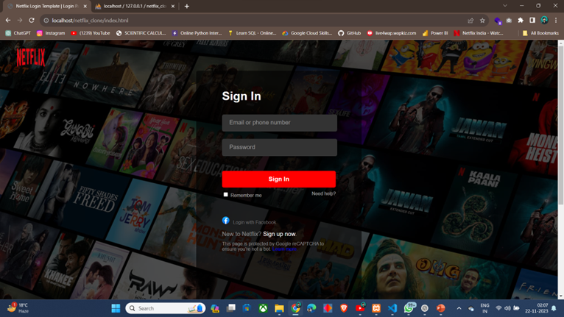
User Interface

Slide 14
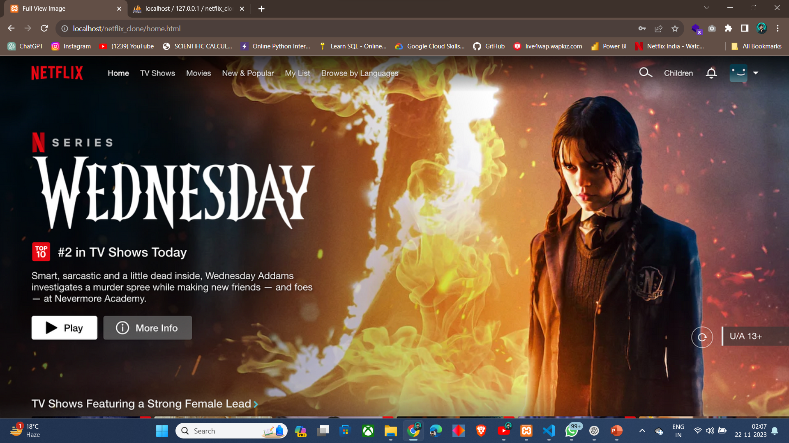
User Interface

Slide 15
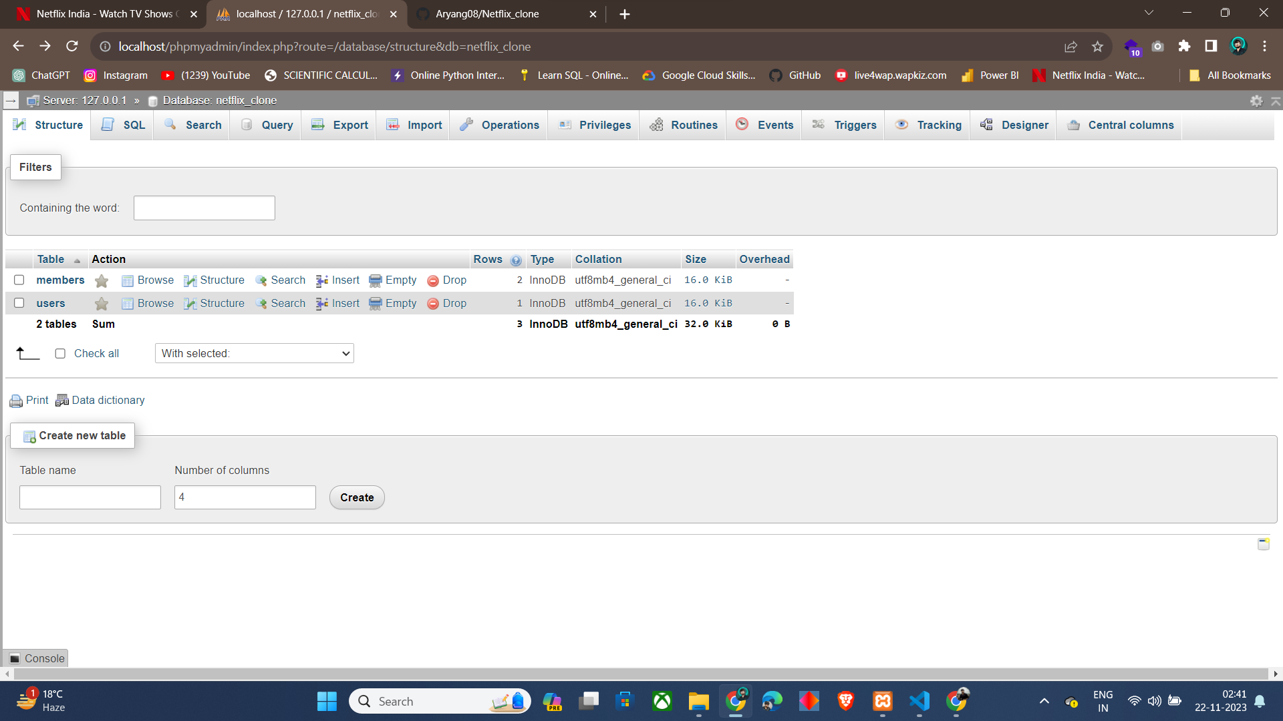
Database Connectivity

Slide 16
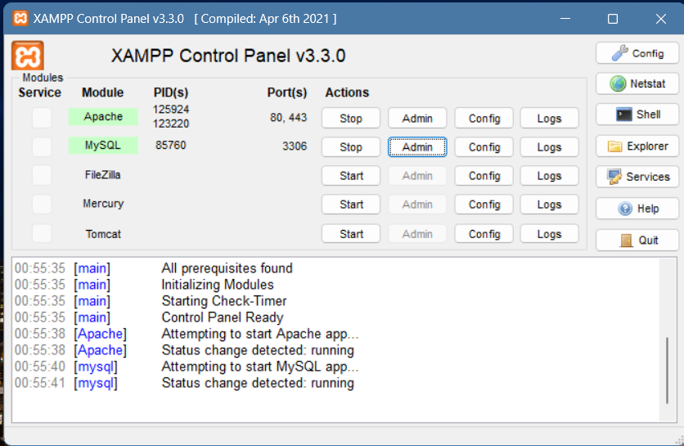
Server

Slide 17
Conclusion
In conclusion, the Netflix Clone project successfully achieves its objectives by providing a functional front-end resembling Netflix's interface and implementing a user registration process. The project utilizes a stack of web development technologies and demonstrates the integration of PHP with a MySQL database. While a simplified version, it serves as a valuable learning experience in web development and server management.

Slide 18
Q&A

Slide 19
THANKS

